Slide 1



Chowgacha - Jhenaidah Model
Dr. Md.Emdadul Haque
Senior National Consultant C -J model replication committee

Slide 2



CHOWGACHA UPAZILA HEALTH COMPLEX
Chowgacha, Jessore.
Previous UHC
Present UHC

Slide 3




Community Mobilization Meeting at Lohagara in 1995

Slide 4
Background History of C-J Model
The program starts in Chowgacha UHC in 1985.
Social mobilization program starts in Lohagara UHC , Narail from 1989 - 1995
In 1995 model activities started effectively.
In June 2008 ,MOH&FW declared the Chowgacha UHC as Model UHC .
In 2010 D G of WHO recommended to replicate it.
Jhenaidah Sadar Hospital Model starts in 2012
C-J Model replicate in 2015 by MOHFW in 11 district hospital & 5 Upazilla UHC.
Replicating by the order of PM office, ADG(Admin) is the Chairperson for replication.

Slide 5
A Hospital with a Vision …
Maximum utilization of Govt.
resources with
honesty and sincerity.
Integrated approach of
Administration, Community
Leaders .
Providing Effective services
through improved
management system.

Slide 6
Characteristics of C-J Health Management Model
Leadership (group / single) in health management.
Goal oriented activites & community engagement.
Optimum use of government resources.
Implement all the component of primary health care .
Improved maternal health & child care services.
Ensuring corner-based health care.
Improved the emergency service.

Slide 7
Characteristics of C-J Health Management Model
Birth and death recording for progress assessment .
Health awareness by health education
Cleanliness and beautification of the facility .
Provision of safe blood transfusion.
Implementation of the 5S KAIZEN-TQM & unit management.
Improved financial management .
Both the institutions awarded many times

Slide 8


Blood donation program stared in 16 December, 1996 in Chowgacha UHC
A seminar held on basic information system at Chowgacha Degree College in June, 1997. DC Jessore was the chief guest .

Slide 9


Health Education Session

Slide 10


Community supported volunteer working in ANC corner
Community Supported Volunteer Working as receptionist.

Slide 11

Upazila Health Complex
CHOWGACHA , JESSORE.
EOC Activities : 1997- 2011 (Hospital Delivery )

Slide 12

Upazila Health Complex
CHOWGACHA , JESSORE.
EOC Activities : 2000 - 2011 (Caesarian Section)

Slide 13
Upazilla Health Complex
CHOWGACHA , JESSORE.
COMMUNITY SUPPORTED MANPOWER
TOTAL :46
  Volunteers :26
  Cleaners & guards :16
  Others :04
  The remunerations come from
  Outsourcing :25
  Service provider :21
  The amount of remuneration ranging from 200/= To 8000/=tk. Per month depending upon the style of work, which costs a total of nearly 90,ooo/=Tk per month.

Slide 14
Chowgacha Health Complex – improvement evaluation (1995-2017)
Subject | 1995 | 1996 | 2000 | 2007 | 2011 | 2017
Bed Occupancy Rate % | - | - | 93.5 | 201 | 208 | 171
ANC (First Visit)% | - | 16.3 (817) | 59 (2861) | 132 (7292) | 170 (8935) | 130 (6632)
Hospital Delivery Rate % | - | 2.1 (99) | 6.4 (422) | 38.1 (1899) | 98.4 (4413) | 66 (2932)
C-Section rate % | - | .02 (1) | 0.07 (3) | 9.6 (473) | 22.5 (1107) | 17
MMR/100,000 live births | 599 | 300 | 168 | 160 | 68 | 91
NMR/ 1000 live births | 42 | 47 | 23 | 21.5 | 18.2 | 16.6
IMR/ 1000 live births | 65 | 58 | 36 | 29.2 | 23.6 | 18.6
U5MR/ 1000 live births | 78 | 67 | 44 | 33.3 | 25.7 | 21.1

Slide 15
Achievement of Chowgacha Health Complex
    Chowgacha UHC declared as the model upazilla health complex in 2008.
  Chowgacha UHC achieved MDG target in 2009.
  Awarded for best performance in EOC form 2005 to 2014 and 2017,2018.
  Achieve Health ministers Award for its best performances in 2016 to 2018.
  The govt. taken the initiative to upgrade to 100 bedded in 2018.

Slide 16


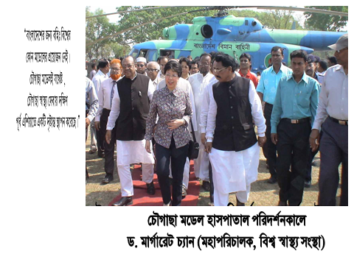
Report on national newspaper
14th October 2005
Visit of WHO DG on, 10th March,2010

Slide 17

100 kh¨v wewkó m`i nvmcvZvj, wSbvB`n

Slide 18
Challenges of the hospital in 2012
Insecured hospital environment
Performance of all activities was very low
Very limited support staff
Receiving money from the patients by non-govt. staff
Waste management system was poor
Monitoring meeting was not performed regularly

Slide 19
Community Support in Jhenaidah Sadar Hospital
Human resource 56
  Cleaner 21
  Ayah & ward boy 22
  Guard 7
  Volunteer 3
  Trolley man 3
Paurasava supports
  Cleanliness
  Renovation of pediatric word
  A biochemistry analyzer.
Others
  A generator
  An inter-com

Slide 20


Innovative activities of Jhenaidah Sadar Hospital Page: 1
Community engagement
Big Cleaning Day

Slide 21


Internal Monitoring System
Meting of community support group committee
Monthly meeting schedule

Slide 22


Use of color code in official file arrangement

Slide 23







Changes in pediatric ward and waste management
Before
After

Slide 24
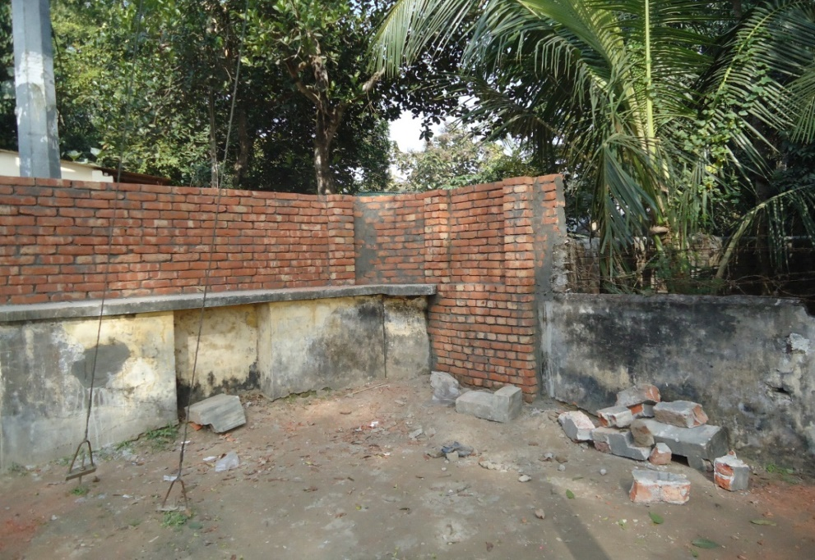

Improved security and recovery of valuable land
Campus protection
Recovered Valuable land after 50 years

Slide 25

Sadar Hospital, Jhenaidah
Bed Occupancy Rate from 1998 to 2018

Slide 26
Emergency & Out Door, Indoor Service 1998 to 2018
Sadar Hospital, Jhenaidah

Slide 27
3 best performing EmOC Hospital in Khulna division - 2018
Sadar Hospital, Jhenaidah

Slide 28
Comparative data of revenue income (in Taka) from 2015 to 2018
Sadar Hospital, Jhenaidah

Slide 29
Achievements of Jhenaidah Sadar
Hospital
1. Active Community Participation is an example in Bangladesh.
2. Improved performance of all services.
3. Improved Cleanliness and Beautification of Campus.
4. Functioning of X-Ray service and Biochemistry investigation
5. Improved Security
6. Improved Financial Management
7. “Model ” is replicating in 20 district hospital & 40 Upazilla hospital
8. The hospital is awarded 7 times from 2013 to 2018.

Slide 30




Hospital Environment
Neonatal Care Unit

Slide 31

Thank You
Notes:
31

Slide 32
Comparative data of health facilities of different country of the world
SL NO | Country | Per capita health Expenditure per year by Govt. ($) | Doctors per 10000 Population | Nurse per 10000 Population | Beds per 10000 population | Out of pocket expenditure %
01 | USA | 9536 | 25.5 | 99 | 37 | 11.08
02 | UK | 4356 | 28.0 | 84 | 30 | 14.79
03 | Malaysia | 386 | 12.8 | 34 | 18 | 36.67
04 | Sri Lanka | 118 | 7.3 | 17.5 | 31 | 38.43
05 | India | 63 | 7.3 | 20.4 | 09 | 65.06
06 | Nepal | 44 | 08 | 4.7 | - | 60.41
07 | Pakistan | 38 | 08 | 06 | 06 | 66.40
08 | Bangladesh | 37 | *05 | *03 | *05 | 67.00
From internet 2018

Slide 33
Community support in Chowgacha UHC
  Human resource 46
    Volunteer 26
    Cleaner&guard16
    Others 4
  A mobile phone
  Dustbins
  A reception center
  Tiles around the pillars of outdoor
  Beautification of road
  Others
    ANC, PNC, Growth Monitoring card
    Drugs for Arsenicosis
    Tyars of Ambulance
    Protocol board

Slide 34
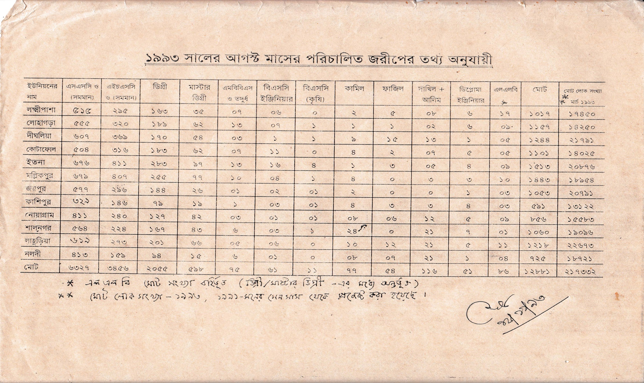
নড়াইলের লোহাগড়া উপজেলায় ইউনিয়নওয়ারী জরীপে জনসম্পদের তথ্য

